Slide 1

ARTIFICIAL
INTELLIGENCE
LOAN ELIGIBILITY PREDICTION
E22BCAU0055-RIYA GUPTA
E22BCAU0115-NIRANJANA ARORA
E22BCAU0074-ADITYA SINGH

Slide 2

Contents
1
Introduction
2
Problem Statement & Solution
3
Hardware & Software Used?
4
Project Flow Chart
5
Code Explanation
6
Application

Slide 3

INTRODUCTION
-In the world of finance, determining a person's or business's loan eligibility through an eligibility assessment is an important decision-making process.
-This project will automate and improve the loan approval process for both lenders and borrowers.

Slide 4

PROBLEM STATEMENT/SOLUTION
Objective: Develop an AI model capable of assessing loan eligibility based on various factors.
-Increase the efficiency and accuracy of the loan approval process.
-Reduce manual effort and human bias in decision-making.
-Provide a user-friendly interface for borrowers to check their eligibility.
Solution: Our model calculates all parameters & predicts if a individual is applicable for a loan in very less time.
-

Slide 5

HARDWARE & SOFTWARE USED?
Hardware Used:
-Windows Computer
Software Used:
-ANACONDA NAVIGATOR
-JUPYTER Notebook
Libraries Used:
-Pandas
-Numpy
Languages Used:
-Python

Slide 6
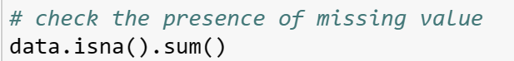
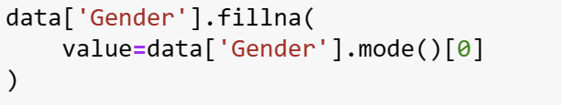
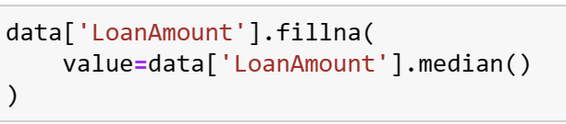
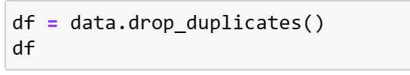
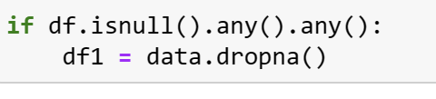
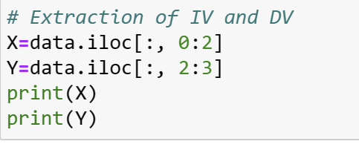
The code data.isna().sum() checks and returns the sum of missing values
(NaN or null values) for each column in the DataFrame named data.
The code fills missing values in the 'Gender' column of the DataFrame 'data' with the most frequently occurring value (mode) in that column.
The code fills missing values in the 'LoanAmount' column of the DataFrame 'data' with the median value of the 'LoanAmount' column.
removes duplicate rows from the DataFrame 'data' and assigns the resulting DataFrame to the variable 'df'.
checks if there are any missing values in the DataFrame 'df'
The code extracts independent variable(s) (IV) and dependent variable(s) (DV) from the DataFrame 'data'. It assigns the first two columns to 'X' as the independent variables and the third column to 'Y' as the dependent variable.
python

Slide 7
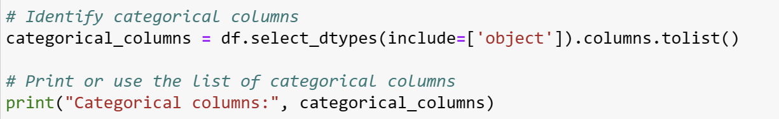
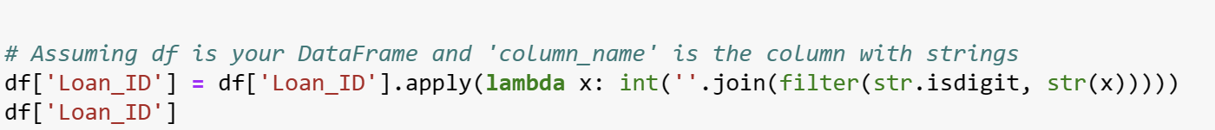
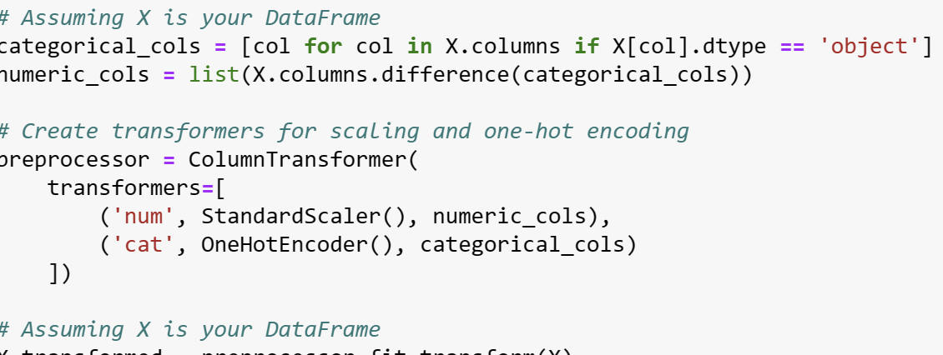
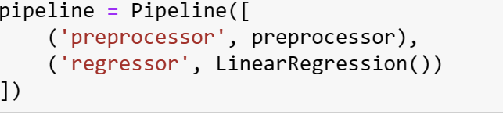
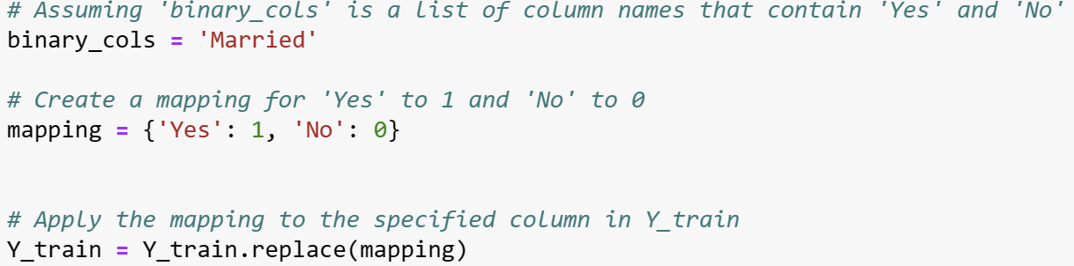
identifies and prints the list of categorical columns in the DataFrame 'df'. It uses the select_dtypes function with the argument include=['object'] to filter columns with object data type
converts the 'Loan_ID' column in the DataFrame 'df' from a string containing alphanumeric characters to an integer. It uses a lambda function with the apply method along with filter and isdigit functions to extract only the numeric digits and then converts the result to an integer.
Code identifies categorical and numeric columns in the DataFrame 'X', then creates a ColumnTransformer named 'preprocessor' with transformers for standard scaling of numeric columns using StandardScaler and one-hot encoding of categorical columns using OneHotEncoder. Finally, it transforms the DataFrame 'X' using the defined preprocessor.
creates a Pipeline named 'pipeline' that combines the preprocessor (defined earlier) and a linear regression model (LinearRegression).
convert the values in the 'Married' column to numeric values (1 for 'Yes' and 0 for 'No')

Slide 8
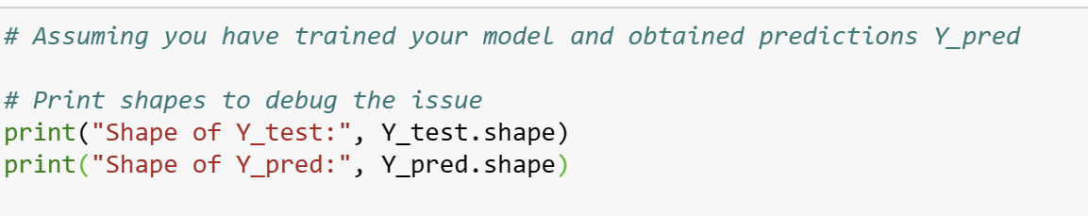
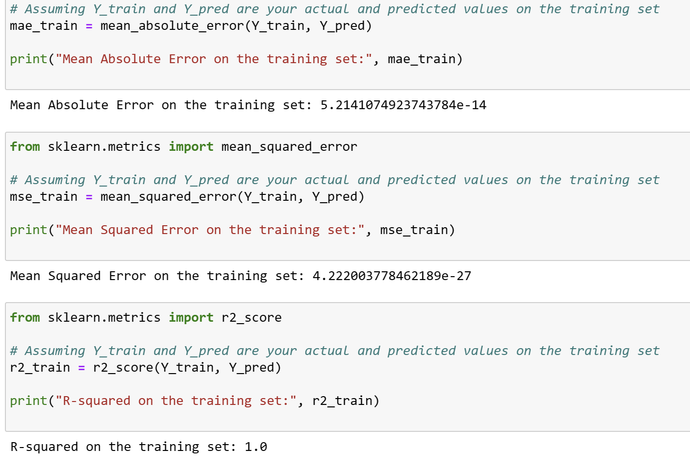
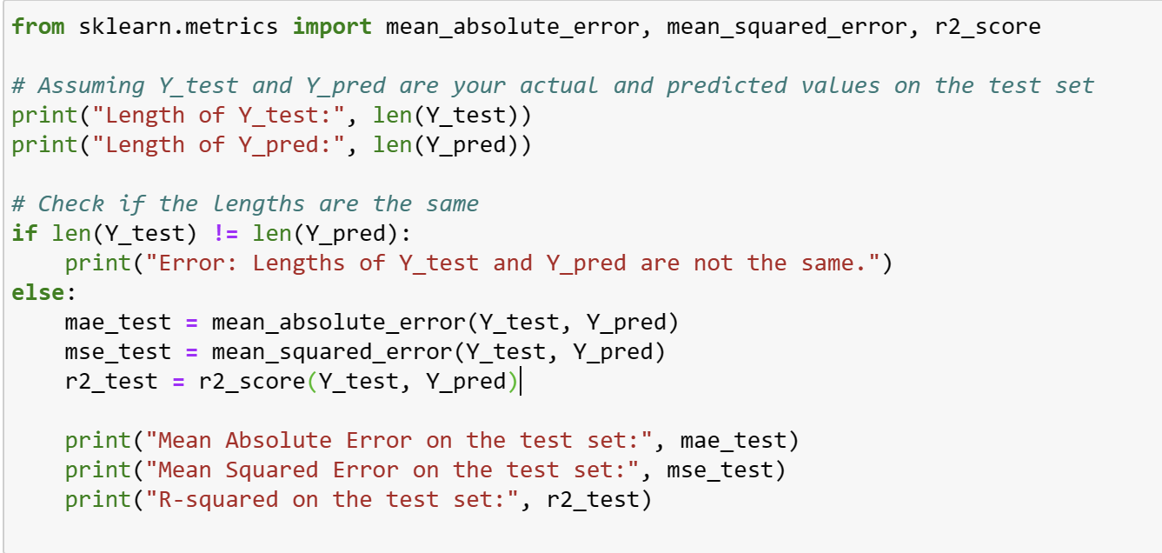
prints the shapes of the 'Y_test' and 'Y_pred' arrays to help debug any issues related to their dimensions.
Mean Absolute Error (MAE) measures the average absolute difference between actual and predicted values.
Mean Squared Error (MSE) measures the average squared difference between actual and predicted values.
R-squared (R2) is a measure of how well the predicted values match the actual values and represents the proportion of the variance in the dependent variable that is predictable from the independent variables.
These metrics provide a comprehensive view of the model's performance on the training set, but it's important to consider additional evaluations, such as testing on a separate validation or test set, to ensure the model's generalization to new, unseen data.
code checks whether the lengths of Y_test and Y_pred are the same and, if not, prints an error message. If the lengths are the same, it proceeds to calculate and print the mean absolute error (MAE), mean squared error (MSE), and R-squared on the test set.

Slide 9


PROJECT FLOW CHART
Data Collection
Feature Selection
Data Import
Model Training
Data Cleaning
Model Evaluation
Data Analysis
Deployment

Slide 10

CODE EXPLANATION
Handling Missing Values
Removing Duplicates
Feature
Extraction
Data Loading
Reads the dataset from the file "loan-test.csv" and stores it in a Pandas DataFrame called data
Checks for missing values in the dataset and prints the sum of missing values for each column
Drops duplicate rows from the dataset and stores the result in a new DataFrame called df.
Extracts independent variables (X) and the dependent variable (Y) from the dataset.
Splitting the Data
Pipeline with Linear Regression
Encoding Categorical Variables
Model Training and Prediction
Splits the data into training and testing sets using the train_test_split function.
Creates a pipeline that first applies the preprocessor and then fits a linear regression model
Encodes categorical variables using LabelEncoder..
Fits the pipeline on the training data and predicts the target variable.

Slide 11



APPLICATION OF LOAN ELIGIBILITY PREDICTION MODEL
BANKING SECTOR
CO-OPERATE
SECTOR
INDIVIDUAL KNOWLEDGE

Slide 12

THANK YOU FOR LISTENING!

